Slide 1
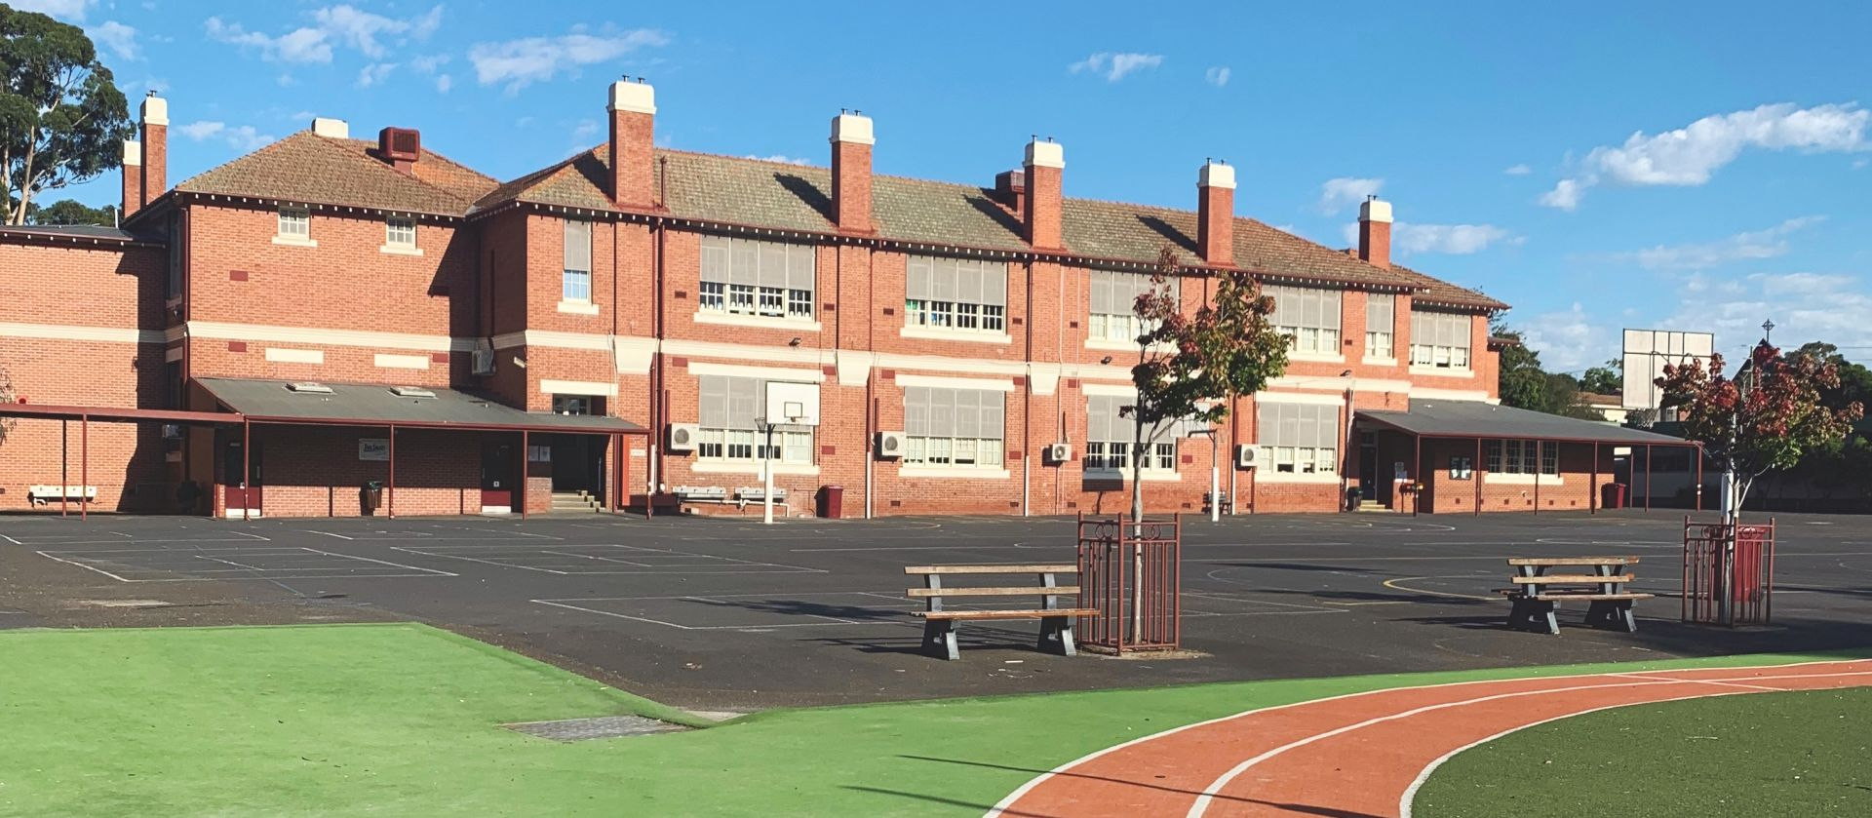
MURRUMBEENA PRIMARY SCHOOL · EST. 1919
A New Gym for Murrumbeena
The case for a full-sized school gym: 550+ students, one half-sized 1996 hall — and a community that has always done its part.
Community advocacy briefing · 2026

Slide 2
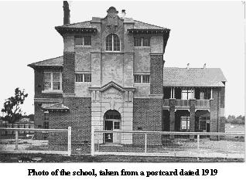
OUR STORY
A Century Built by Parents
1919 — the school opens its doors to Murrumbeena families
1929 — swimming pool built with parent funds
1990 — pool heating paid for by the school fete
1992 — amphitheatre built by the community
1996 — school hall built with 100% parent donations
2025 — nearly $1 million raised locally in a single year
Murrumbeena State School, 1919
Generations of Murrumbeena families have built this school with their own hands. The hall was their proudest gift — a full-sized gym is now our most urgent need.
Murrumbeena Primary School — The New Gym Campaign
2

Slide 3
THE CASE AT A GLANCE
Twelve Arguments, One Conclusion
CORE
MAJOR
SUPPORTING
Gym-space equity — 0.72 m² of indoor space per student, 22nd of 27 nearby schools; a quarter of the funding per student
An apartment suburb with no indoor court — 54% of homes are flats or townhouses; a 220-court statewide shortage
The State's own housing plan — 6–12 storeys gazetted at Murrumbeena; 63,500 more homes for Glen Eira
Girls' & women's sport — 42-team Murrumbeena Netball Club, founded by MPS parents; ~200 teams outdoors at Duncan McKinnon
Growth capped by capacity — formal enrolment restriction; hall ~half standard size
A tri-council asset — Glen Eira, Monash & Stonnington
Wellbeing & inclusion — programs in improvised spaces
Climate & emergency resilience — no relief centre in the local cluster
Youth engagement — prevention infrastructure, not a cost
We've paid our way — parents built the 1996 hall
Condition & dignity — rated "Poor" in VSBA's own data
The system rewards advocacy — VAGO, 2026
Every minister, every department, every door — an argument built for each. One conclusion.
Full evidence table: campaign briefing note 'Argument Frames & Priorities' (2026) — sources cited on each slide
3

Slide 4
EXCELLENCE
A Top-Performing School, in a Bottom-Tier Hall
#7
91.9%
Year 3 Reading Strong/Exceeding (state 69.5%)
93.5%
Year 3 Numeracy Strong/Exceeding (state 66.2%)
government primary school in Victoria — 18th across Australia
94.8%
Year 5 Numeracy high/medium growth (state 74.0%)
"We're excited to share that our school has been ranked 7th among government schools in Victoria and 18th across Australia in this week's Herald Sun rankings."
91.1%
parent satisfaction (state 82.0%)
Herald Sun Top 100, May 2026 — via MPS Newsletter, Issue 7
Top-2% results, delivered in facilities our community would not accept.
NAPLAN 2025, School Performance Summary — MPS Annual Report (VRQA)
4

Slide 5
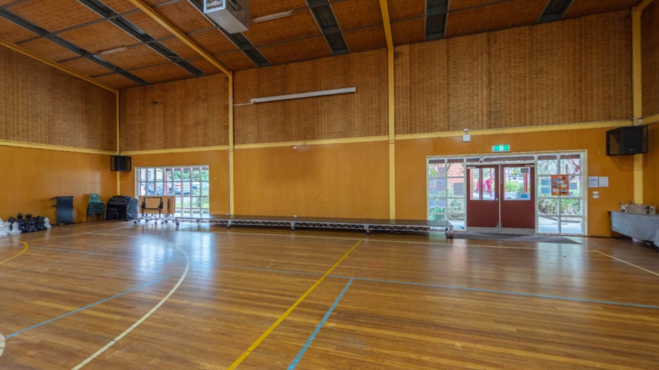
THE PROBLEM
Our Hall: A 1996 Parent-Built Stopgap
To scale: a standard gym vs our hall
VSBA competition envelope — 36.6 × 21.35 m = 781 m²
the missing half — no room for a full court
MPS 1996 hall
≈ 400–430 m²
The MPS hall today — built with 100% parent donations in 1996
Envelope: 30.5 × 15.25 m court + 3.05 m run-offs (BQSH spec), 7.5 m ceiling · hall shown area-proportional — actual dimensions not supplied
About half the size of a standard school gym
Failing sub-floor plumbing — rated "Poor" (3.1) in VSBA's own condition data
550+ students
cannot assemble under one roof
Murrumbeena Primary School — The New Gym Campaign · Condition score: VSBA facilities data, Dec 2025 (school-supplied)
5

Slide 6
THE FUNDING GAP
Ten Years of State Funding: The Short Bar
Oakleigh South
$8.85M
6%
of the funding — for ~22% of the students across these four neighbouring schools
Glen Huntly
$7.12M
Carnegie
$5.50M
¼
Murrumbeena
$1.39M
≈$2,500 per MPS student vs ≈$11,200 average next door
State government capital funding 2016–2026, VSBA school project pages
Less than 0.01%
of the State's $14.9 billion, nine-year school building program
Murrumbeena Primary School — The New Gym Campaign
6

Slide 7
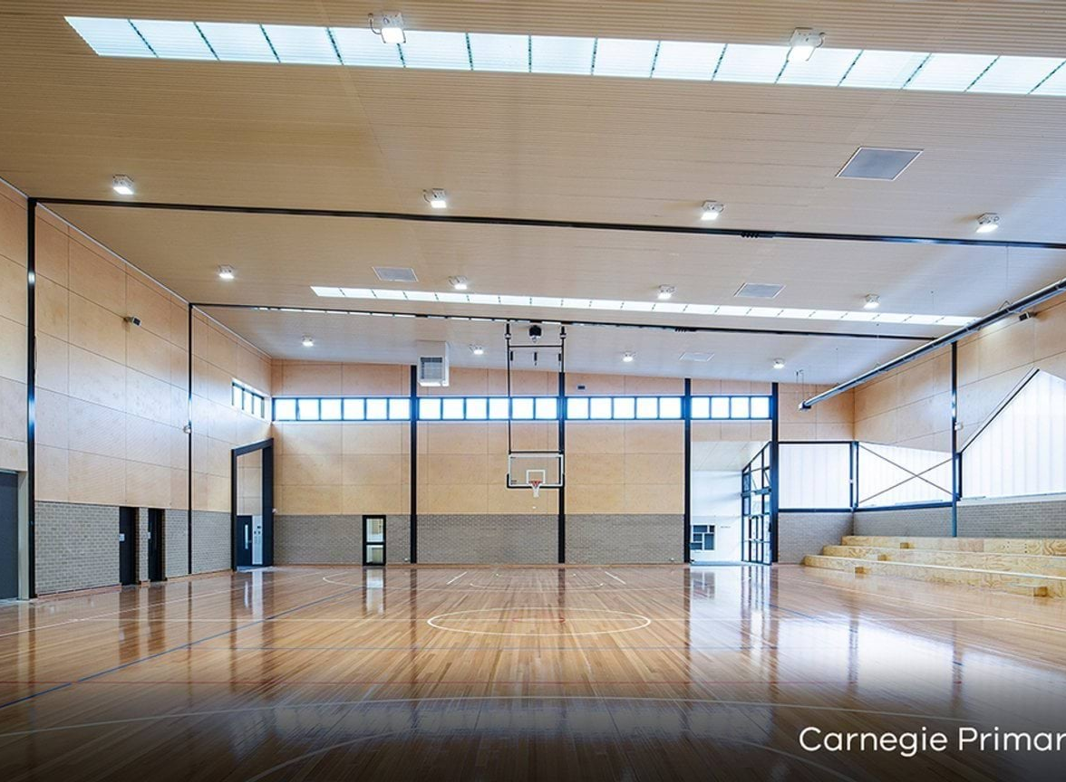
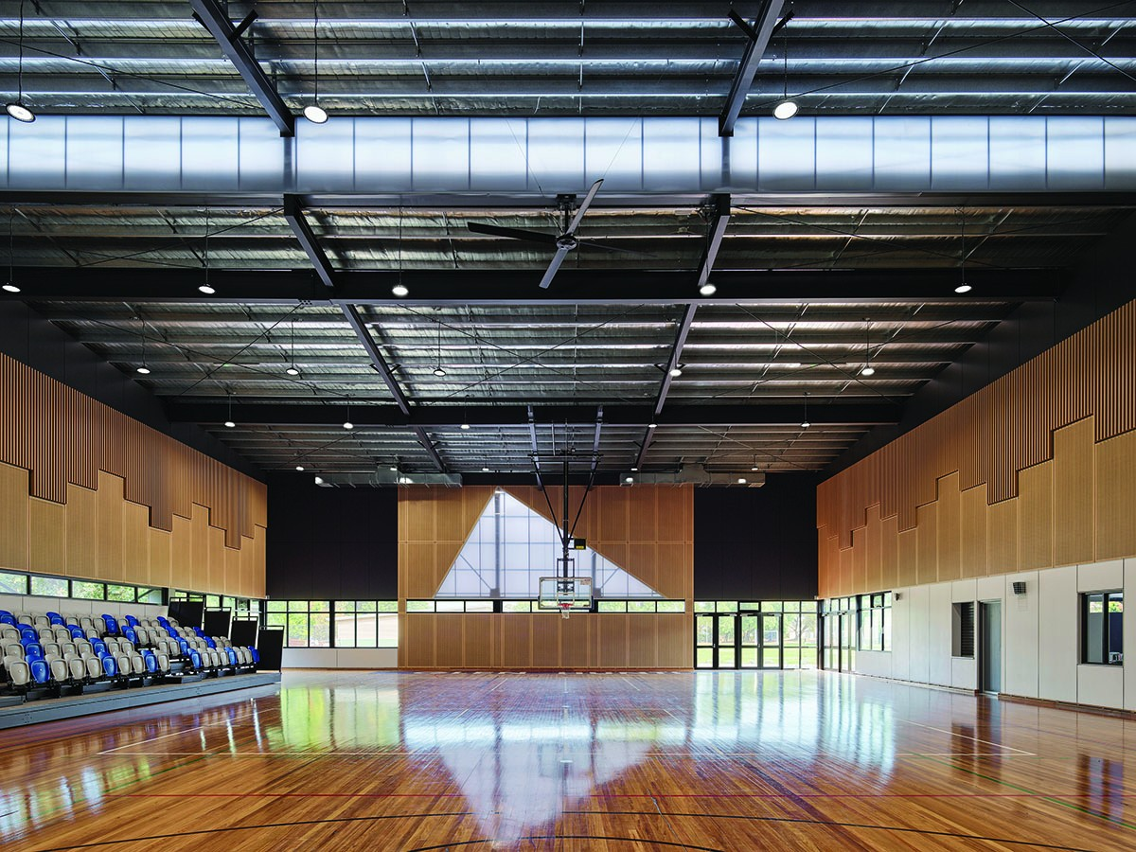
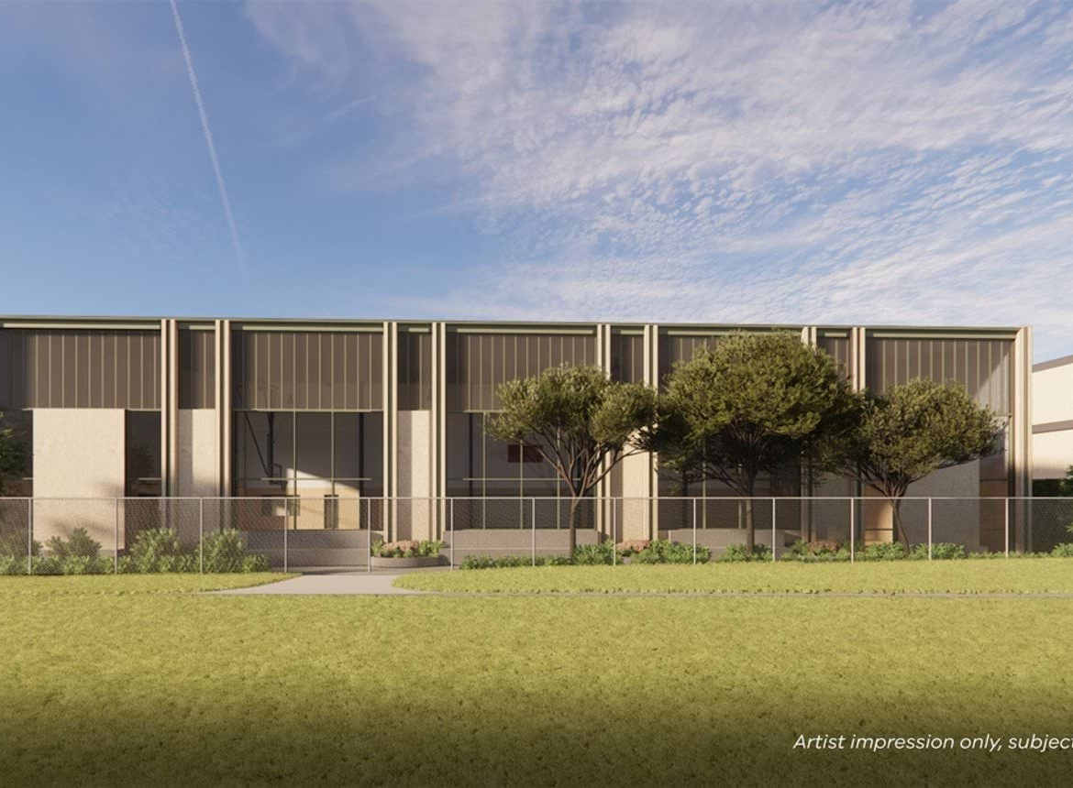
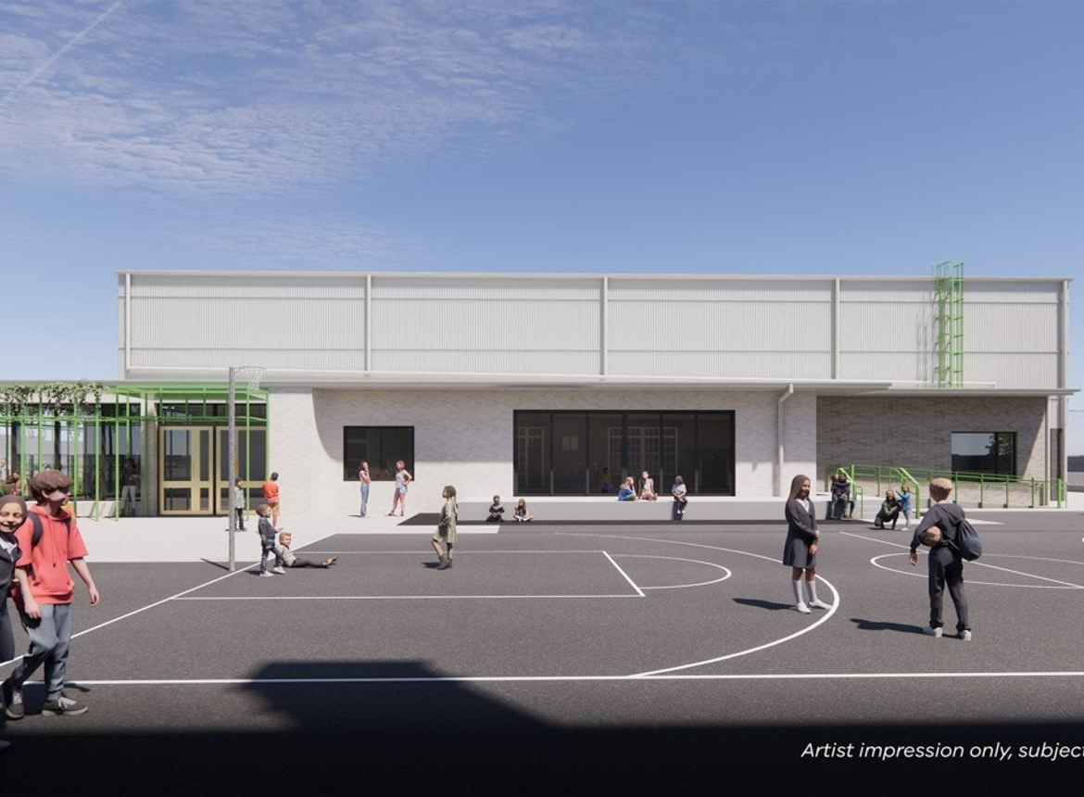
THE STANDARD NEXT DOOR
What $31.4 Million Is Building Around Us
Carnegie PS — games hall, $5.5M upgrade · opened 2021
Glen Huntly PS — new gym, $7.12M upgrade · opened 2023
Caulfield South PS — competition-grade gym, $9M · under construction (render)
Hampton PS — gym & performing arts, $9.8M · under construction (render)
Two built, two under construction within a few kilometres — all state-funded since 2020.
In May 2026, St Kilda PS won $13.2M for a competition-grade gym — after a sustained community advocacy campaign.
Photos: Carnegie PS gym (2024 Victorian School Design Awards); Glen Huntly PS · Renders: VSBA, schoolbuildings.vic.gov.au · City of Port Phillip, 2026
7

Slide 8
EQUITY IN SQUARE METRES
The Least Indoor Gym Space per Student Around
Parkhill PS
4.66 m²
Glen Huntly PS
2.84 m²
Oakleigh South PS
1.91 m²
Carnegie PS
1.51 m²
Murrumbeena PS
0.72 m²
Indoor gym/hall space per student — MPS ranks 22nd of 27 nearby schools. MPS's only capital works in a decade: $1.1M (2019–20) and $290k (2016–17) — no gym.
Equity is not special treatment — it is the same treatment.
Sources: School Council analysis of VSBA enrolment & facilities data, 2025 · DE school building funding records
8

Slide 9
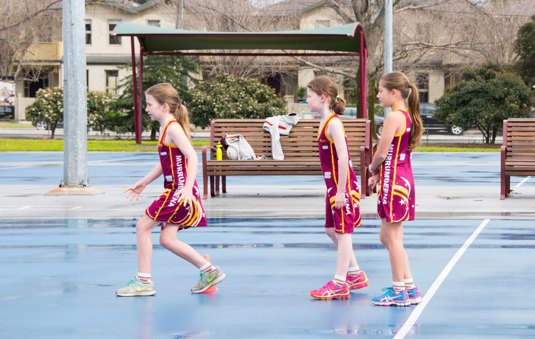
A COMMUNITY ASSET
An Apartment Suburb Needs an Indoor Court
54.4%
of Murrumbeena homes are flats, apartments or townhouses (state 26%) — backyards are optional here
36.4%
of households rent (state 28.5%) — families who can't book a backyard court
Zero
bookable indoor courts in the Carnegie–Murrumbeena–Hughesdale corridor today
220
extra courts needed in Victoria now; 25% of games already become "manufactured byes" (Basketball Victoria, 2025)
Murrumbeena Netball Club training — outdoors, whatever the weather
Murrumbeena Netball Club: 42 teams — founded by MPS parents, no indoor home
~200 teams play outdoor-only at Duncan McKinnon Reserve (Caulfield & District NA)
A school gym is the cheapest indoor court Victoria can build — shared with the community by design.
Sources: ABS Census 2021 (Murrumbeena) · Basketball Victoria Facility Guidelines 2025 · mnc.org.au · cdna.net.au · corridor audit: School Council
9

Slide 10
THE STATE'S OWN PLAN
The Suburb Is Being Rezoned to Grow — the School Isn't
6–12 storeys, gazetted at the school
63,500 more homes for Glen Eira
Murrumbeena Activity Centre controls took effect 31 March 2026 (amendment GC270) — thousands of new residents on the school's doorstep.
The State's own Plan for Victoria housing target to 2051. Growth is policy — the indoor space to hold it must be policy too.
A tri-council catchment
Enrolment capped by indoor space
Serving Glen Eira, Monash and Stonnington. Monash's relief centres are sports venues; Stonnington already runs a school-managed public court (Penpraze Park).
557 students under a formal s2.2.16 enrolment restriction. In-zone children keep the right to enrol — a cap cannot fix the buildings.
The State is planning for more people. It must also plan for the places that will hold them.
Sources: Planning Victoria (GC270; Plan for Victoria housing targets) · Education and Training Reform Act 2006 · council emergency arrangements
10

Slide 11
THE ANCHOR
A School That Holds the Community Together
Est. 1919 — 106 years as Murrumbeena's shared institution
91.5%
student sense of connectedness (state 77.1%)
The suburb's voting centre — polling place at state and federal elections
91.1%
parent satisfaction (state 82.0%)
~80 children a day — TheirCare before/after-school and holiday care, run from the hall
15.8 days
average student absence vs 21.5 statewide
Fete, musical, Grandparents' Day — the community's calendar runs through the school
A school that holds a community together deserves a hall that can hold the school.
Sources: MPS 2025 Annual Report (VRQA) · VEC 2022 voting centres · AEC polling places
11

Slide 12
COMMUNITY & SPORT ASSET
One Gym, Many Roles
Sport
The Arts
OSHC
Canteen
Wellbeing
All-weather PE, inter-school sport and community sport hire
School musical, concerts, assemblies and graduation
TheirCare before/after-school and holiday care — up to ~80 children a day
Canteen and kitchen-garden program, self-funded
A safe indoor space for 550+ children in heatwaves, storms and poor-air days
One investment. Five daily uses. 550+ students — and the wider community.
Murrumbeena Primary School — The New Gym Campaign
12

Slide 13
SELF-RELIANCE
Our Community Does Its Part
Building & Library Fund
Self-funded Capital Work
■ Portable classrooms refurbished — new paint, carpets, pinboards and furniture, paid for by Trivia Night proceeds and school savings
■ COLA — large covered outdoor learning area over the basketball court, school-funded, in process with VSBA
■ Sports grounds — re-asphalt and line-marking planned alongside the COLA works
■ Playgrounds & STEM room — parent-funded, topped up by the school
Established by parent donations — tax-deductible contributions of $150 (Building) and $50 (Library) per family each year
Fundraising
Multiple social events all year round; bi-annual fete raising funds from parents
We have been neglected for having good finances.
Sources: MPS 2025 Annual Report (VRQA) · MPS Newsletters Issues 7 & 13
13

Slide 14
VALUE FOR MONEY
Ready to Build
Shovel-ready
One structure, five uses
Stage 2 & 3 of the school's VSBA-approved 2018 masterplan. No land to buy, no planning risk — funding is the only missing piece.
PE, the arts, OSHC, canteen and community sport in a single building — the hardest-working square metres a primary school can build.
A durable fix, not a patch
A rounding error, statewide
The 1996 hall's sub-floor plumbing is failing. Replacement ends the cycle of sunk-cost repairs.
A full-sized gym costs less than 0.01% of the State's $14.9 billion school building program — small for government, transformative here.
Murrumbeena Primary School — The New Gym Campaign
14

Slide 15
THE ASK
Fund the New Gym in the 2027–28 State Budget
Fund Stage 2 & 3 of Murrumbeena Primary School's VSBA-approved masterplan — classroom expansion and a full-sized gym for 550+ students, and a year-round sport and community asset for the district.
Victoria's Auditor-General (2026): upgrade priorities can hinge on community advocacy and an "active local member" — and election commitments bypass the queue entirely. This campaign is how Murrumbeena becomes one.
"A bipartisan funding commitment is not costly to governments but great for the election result."
"This is the kind of decision a government never regrets and a community never forgets."
Murrumbeena Primary School Council — The New Gym Campaign · murrumbeenaps.vic.edu.au

